Slide 1

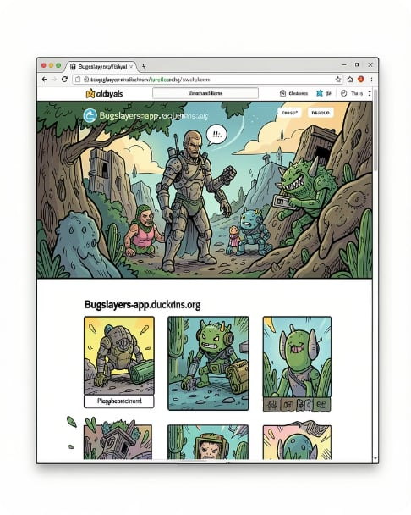

BugSlayers — ATS Resume Analyzer
AI-powered Resume Analysis Platform · Cloud-native DevOps Transformation
Helping job seekers improve their resumes before they reach recruiters — scored, analyzed, and optimized for real Applicant Tracking Systems.
Team
Website
Mahammad Mammadov • Polad Aliyev • Farida Babayeva • Fidail Valiyev
bugslayers-app.duckdns.org

Slide 2
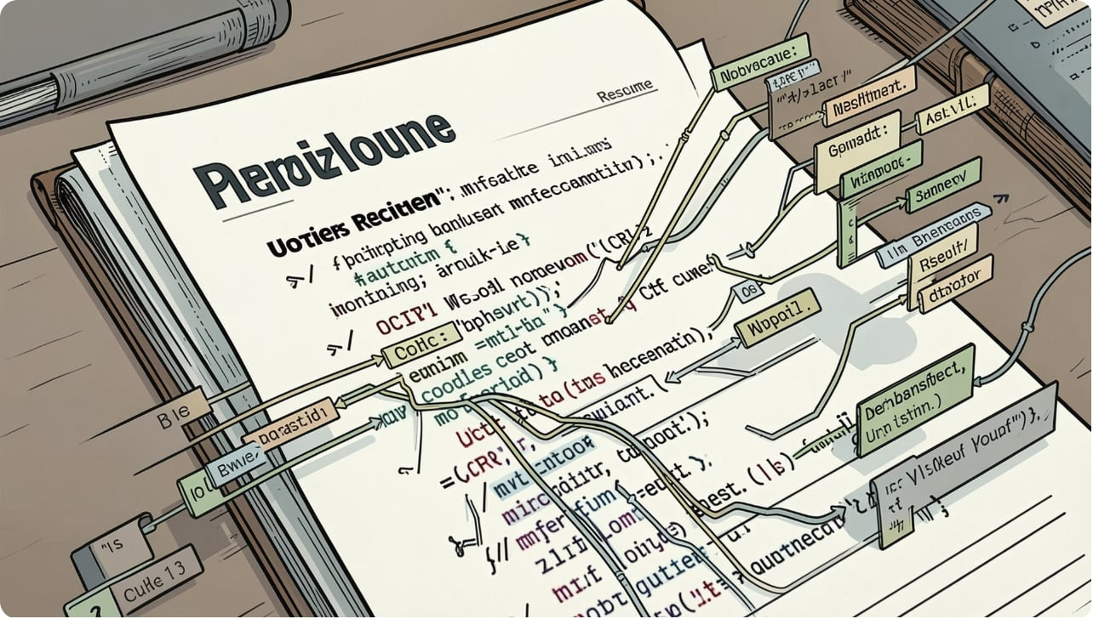

The Hiring Problem
Most applications are filtered by Applicant Tracking Systems before a human ever sees them. Qualified candidates are frequently rejected due to formatting, missing keywords, or parsing errors.
Why it matters
Resumes get rejected for structural or keyword mismatches.
Candidates lack visibility into ATS evaluation before applying.
Small formatting issues create big hiring friction.
Our mission: Make resume evaluation transparent and actionable before submission.

Slide 3
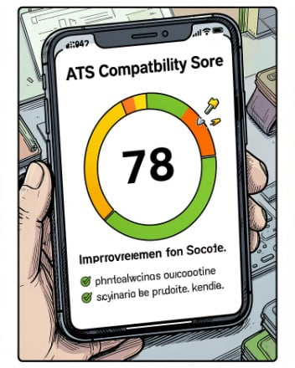
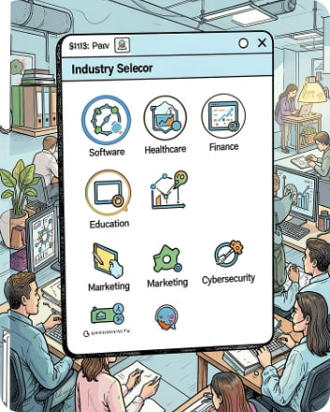
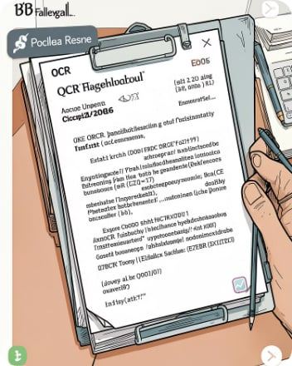
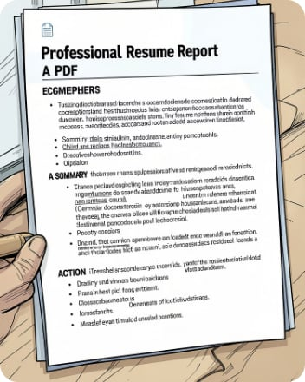
Meet ATS Resume Analyzer
AI-driven feedback that transforms a resume from a black box into clear, actionable improvements.
Score & Insights
25+ Industries
Robust Parsing
Professional Report
Instant ATS Compatibility Score plus prioritized, explainable suggestions.
Industry-specific rules and keyword matching across 25+ fields for targeted feedback.
DOCX/PDF first; OCR fallback for scanned resumes ensures no candidate is left behind.
Exportable PDF report with prioritized fixes — ready to act on before applying.

Slide 4
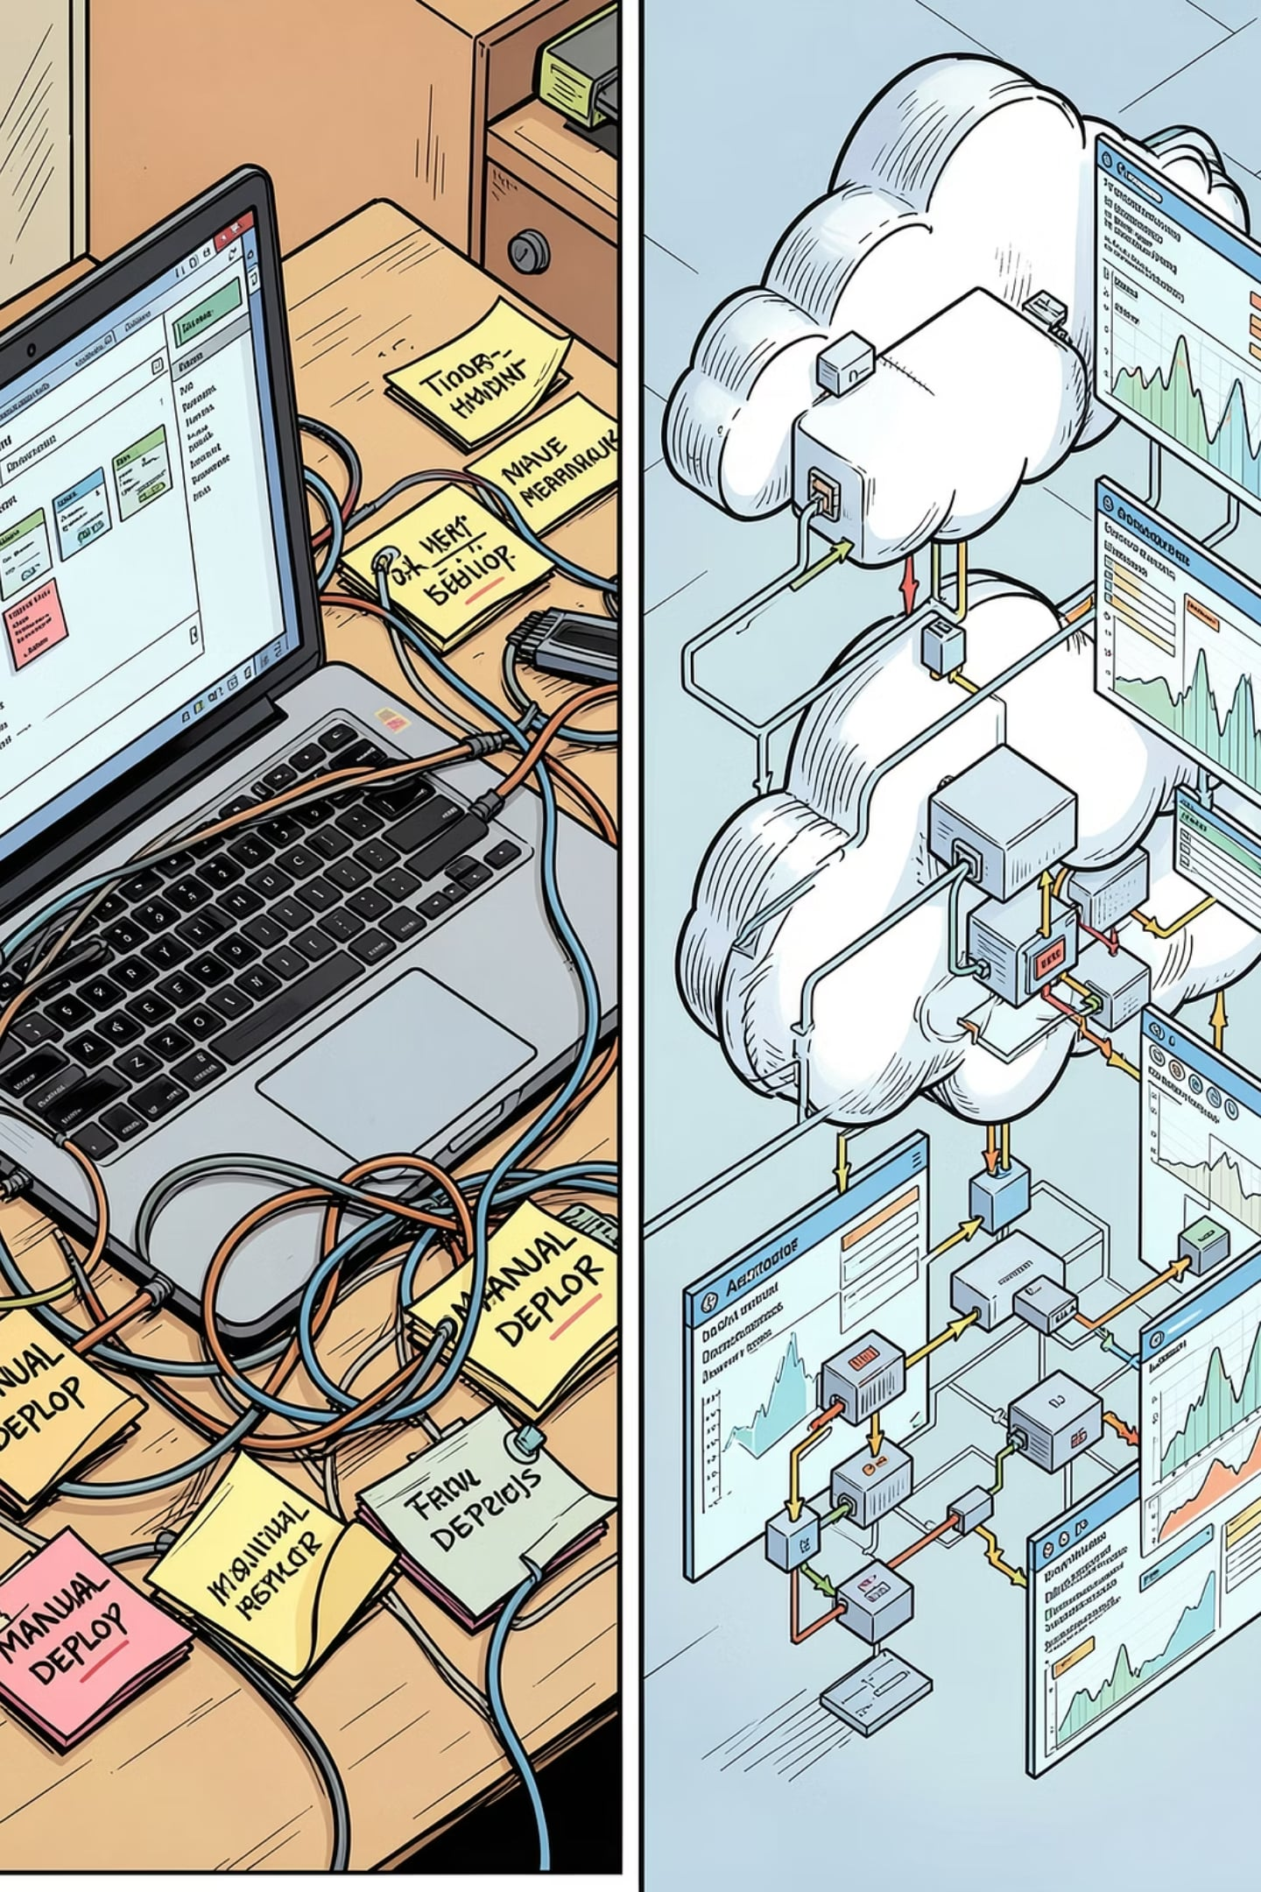
Why DevOps?
"Building an intelligent application solved one problem. Making it reliable, scalable and production-ready solved another."
Before — Fragile
After — Production-ready
Manual deployments, ad-hoc infra, no CI/CD, and high operational risk.
Automated pipelines, infrastructure as code, monitoring, security and scalable clusters.

Slide 5
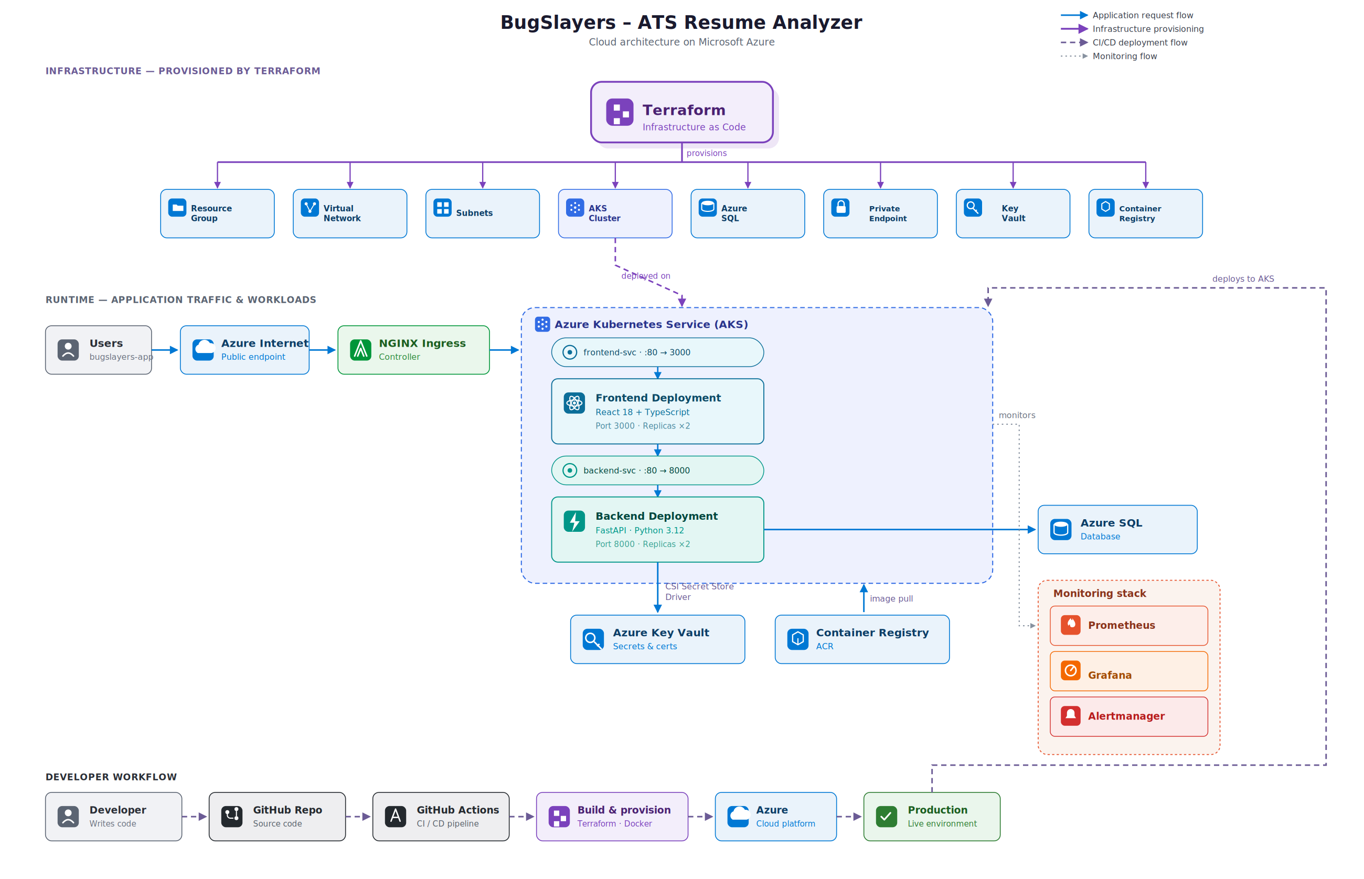
Cloud Architecture

Slide 6
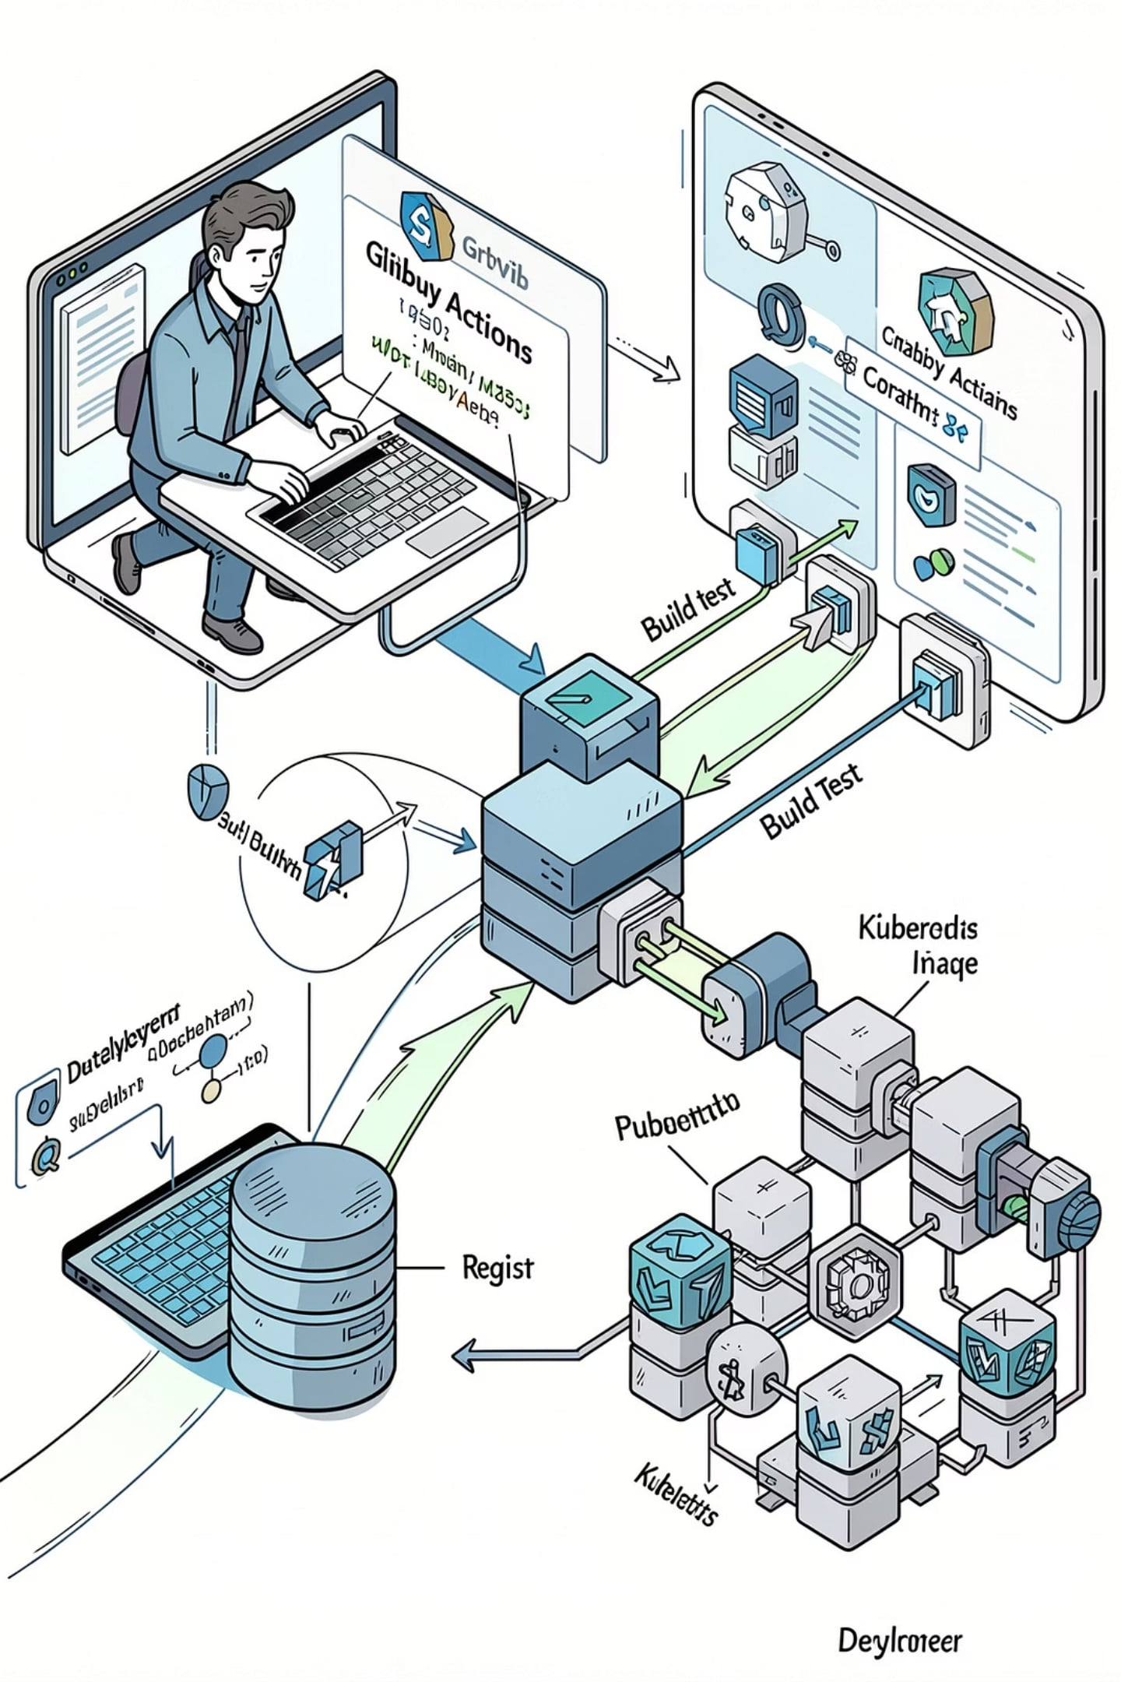

CI/CD Pipeline
Automated, auditable paths from developer laptop to production with clear separations for frontend and backend.
Key Practices
Separate frontend & backend pipelines for independent releases
Infrastructure as Code (Terraform) for reproducible environments
Rolling updates & immutable images to reduce deployment risk
Developer
GitHub
Build & Test
Container Image
Value
Faster, safer releases with clear rollback paths and traceable builds.

Slide 7
Security & Reliability
Every technology choice supports a specific operational risk or trust requirement — we start with the why, then the how.
HTTPS (DuckDNS + TLS)
Azure Key Vault
Private Azure SQL
Protects user data in transit so applicants can upload resumes securely.
Centralized secret management reduces leakage risk and simplifies rotation.
Isolated storage for sensitive candidate data with RBAC and network controls.
AKS + HPA
Health Checks & RBAC
Horizontal scaling and rolling updates keep the service responsive and available under load.
Automated probes and role-based access reduce downtime and limit blast radius.

Slide 8
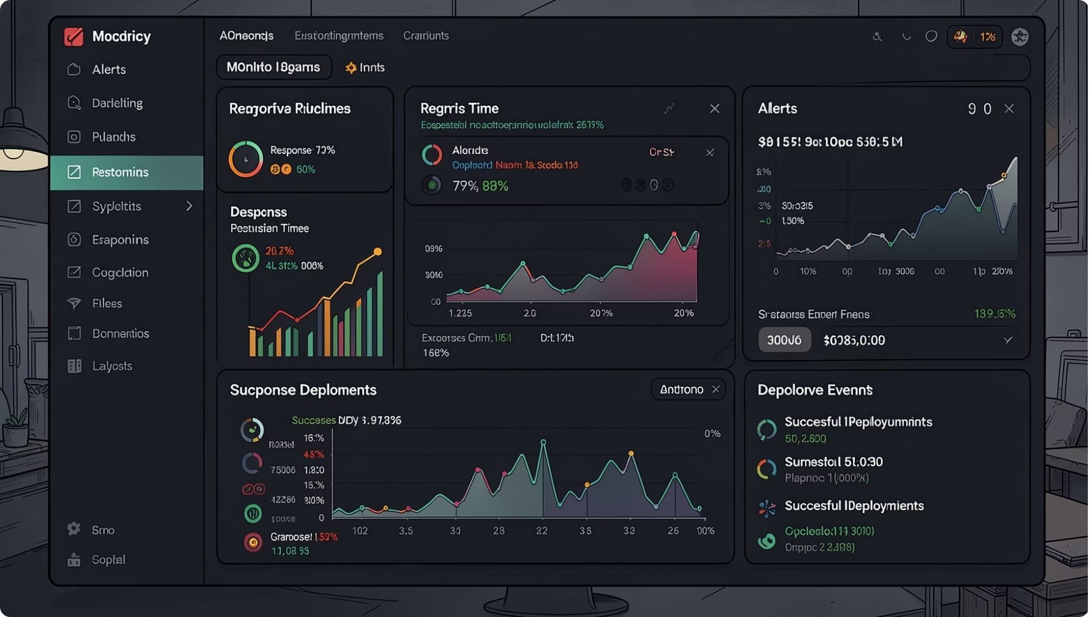
Monitoring & Operations
Monitoring turned from an afterthought into an operational advantage — observability drives confident releases and fast incident response.
What we measure
Application health & latency
Infrastructure metrics: CPU, memory, pod counts
Custom traces: parsing success, OCR rates
Tools
Prometheus for metrics collection
Grafana dashboards for SRE visibility
Load testing and alerting for performance guardrails

Slide 9
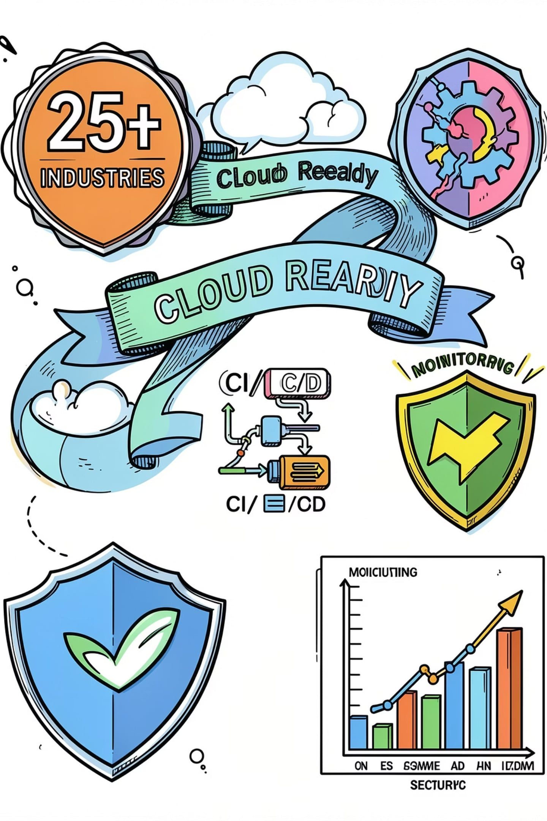

Project Impact
From a local prototype to a production-ready platform delivering measurable value to job seekers and hiring ecosystems.
Product
Platform
AI Resume Analysis with OCR fallback, industry-aware scoring, and exportable PDF reports.
Production deployment on AKS, automated CI/CD, infrastructure as code, separate pipelines.
Operational
Monitoring, secrets management, HTTPS, rolling updates, and horizontal scaling for reliability.
Our application evolved from local code into a secure, scalable service ready for real users and real hiring workflows.

Slide 10

Lessons Learned & Next Steps
Key Lessons
Software alone isn't enough — packaging and ops matter.
Automation saves time and reduces human error.
Monitoring prevents small issues from becoming outages.
Reproducible infrastructure enables confident scale.
bugslayers-app.duckdns.org
Planned Improvements
Telegram notifications for critical alerts
Advanced model telemetry & metrics
Canary deployments for safer rollouts
Cost optimization and AI model refinements
Thank you — Questions?

